Slide 1
IBM Bluemix Survey
By: Jeevana Tunuguntla
Saitejasree Ramala
Goutham Marikanti

Slide 2
Introduction
The application we are developing is providing a survey about bluemix resources and its services.
This is a mobile based Cloud Application exclusively for UMKC Students.

Slide 3
About the App…
In this application, we are making use of the Mobile data provided by Bluemix and also the three property keys provided for Mobile Cloud Applications.
In this Mobile application, the student will login using his/her UMKC SSO and Password.

Slide 4
Cont…
Once the student logins to Bluemix, he then gives his opinions for the questions provided according to their experience on Bluemix.
He then navigates to the next questions in the other pages to complete the survey.
Once the survey gets completed, it will be submitted.

Slide 5
Demo
This is how our Mobile Application is going to work:

Slide 6
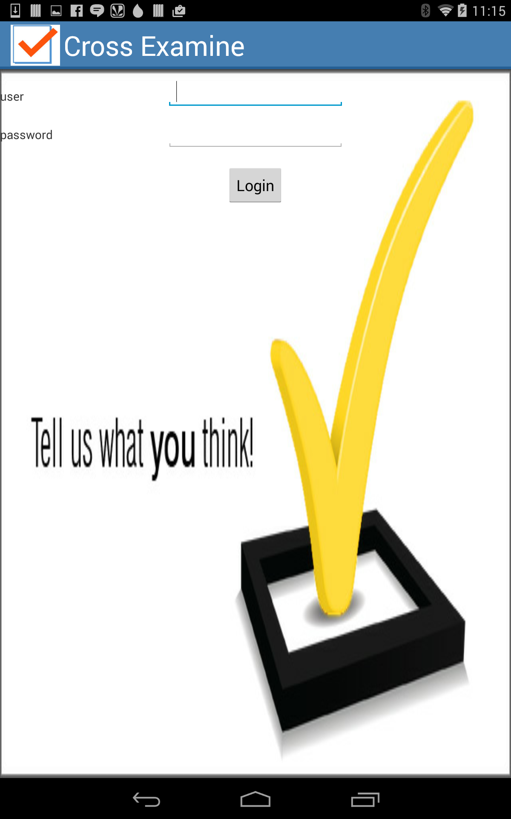

Slide 7
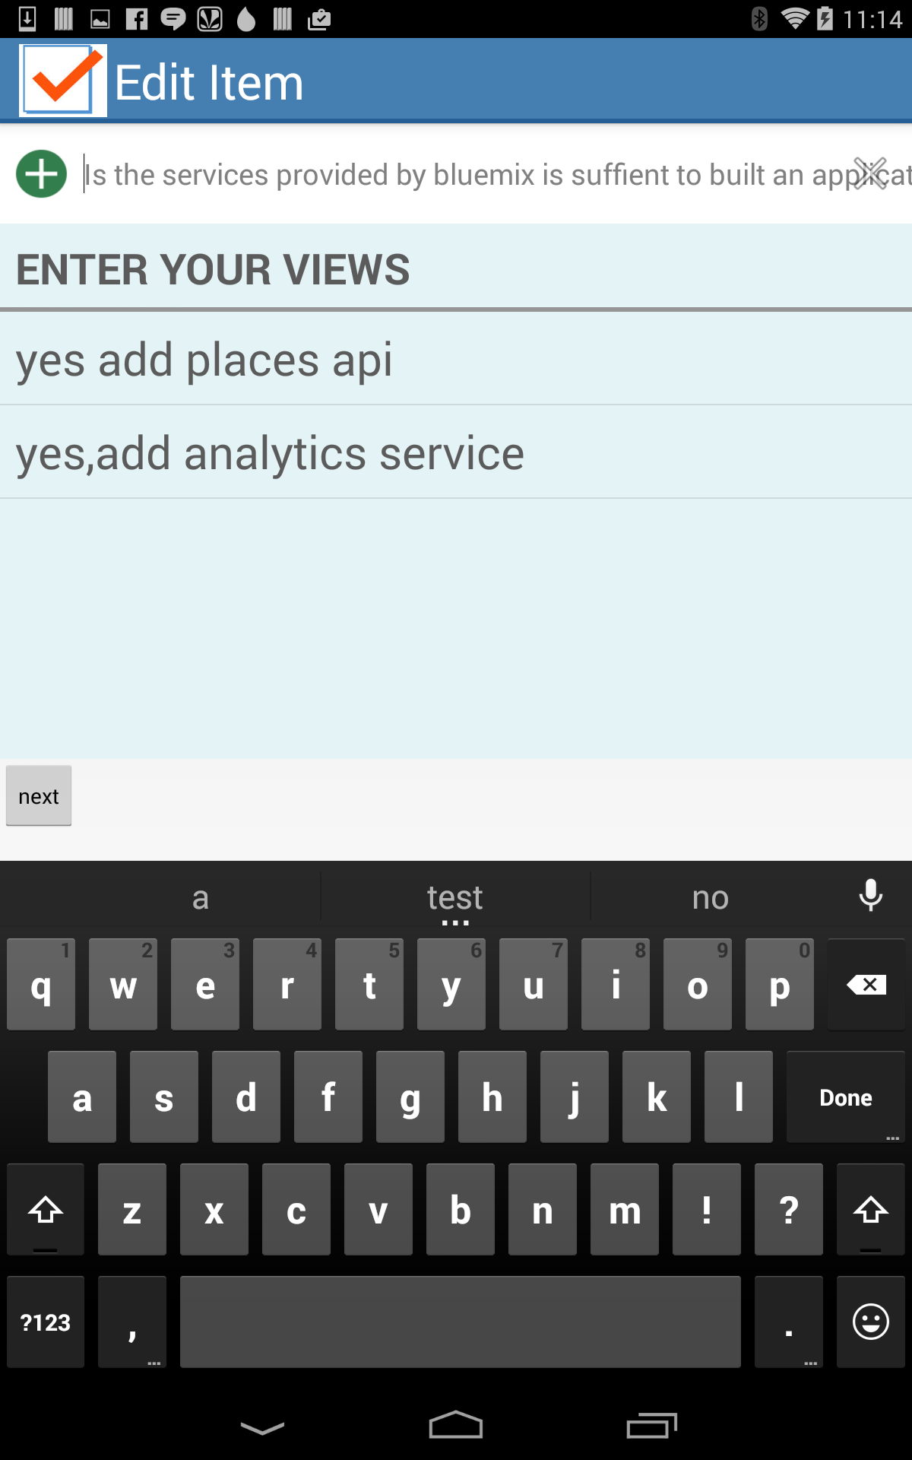

Slide 8
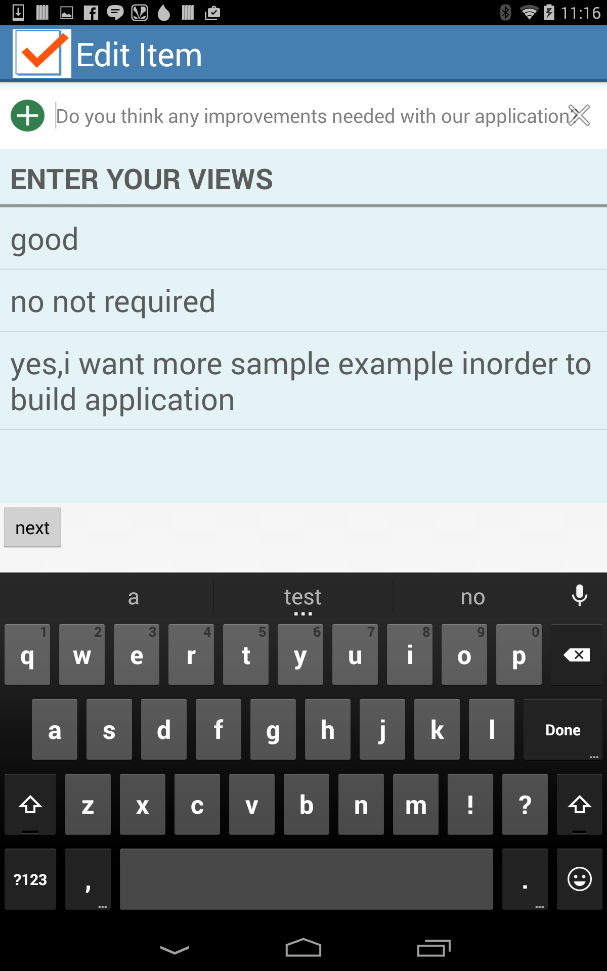

Slide 9
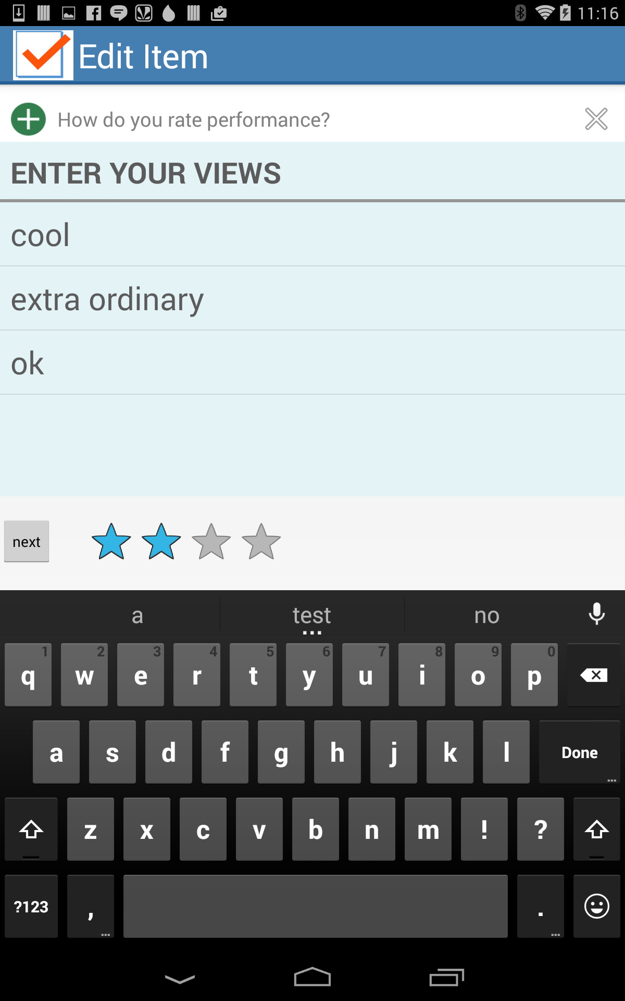

Slide 10
Conclusion
This application mainly uses Android Platform.
In this application, the students provides their feedback about Bluemix and thereby helps the Bluemix developers to develop in a way that is preferred by many students.
Therefore, this encourages most of the students to use Bluemix for developing their applications.

Slide 11
Queries???

Slide 12
Thank You!!!

